Slide 1
TEAM A
Andreas schörgenhumer, markus hiesmair, onur kirkizoglu, raphael sulzer, tariq al mousa User-Generated data, 19.04.2016

Slide 2
Contents
Data analysis
Proposed methods
Experimental setup
Results
Conclusions

Slide 3
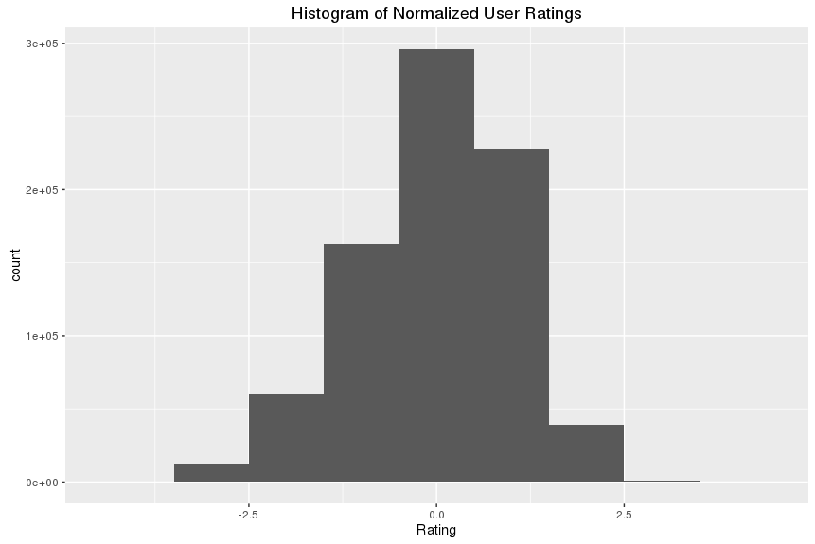
Data analysis
Ratings are integer-values from 1 – 5
Normal distribution with highest density at the rating of 4

Slide 4
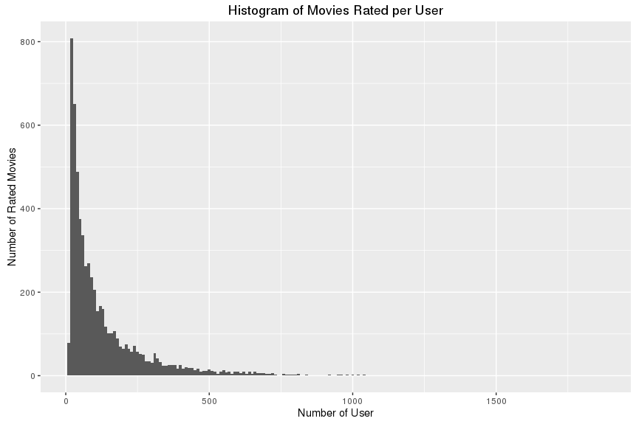
Data analysis
More than 50% of the movies have a rating of 4 or 5
Algorithms should work good for users with a small amount of ratings, as well as with eventually unknown users or movies

Slide 5
Proposed methods
Memory-based methods
User-based Collaborative Filtering Recommendation (UBCF)
Item-based Collaborative Filtering Recommendation (IBCF)
Model-based methods
Singular Value Decomposition (SVD)

Slide 6
Experimental setup
Predictions are evaluated by Root-Mean-Squared-Error
The configuration of every method were tested on a training-set size of 90% (10% test data, no overlap)
UBCF & IBCF with configurations: k = 20 up to k = 50 with steps of 5
SVD with configurations: cycles = 30, 35, 40, 50, 55, 60, 80, 120
3 iterations for better assessment
Simple averaging-method as baseline

Slide 7
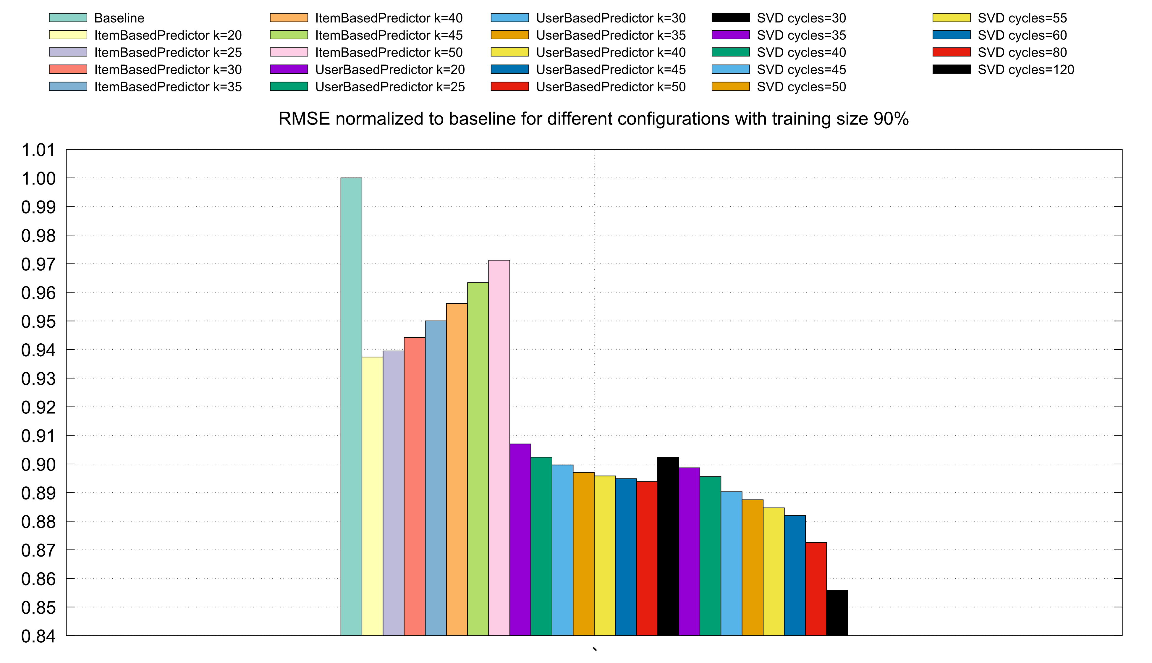
Results

Slide 8
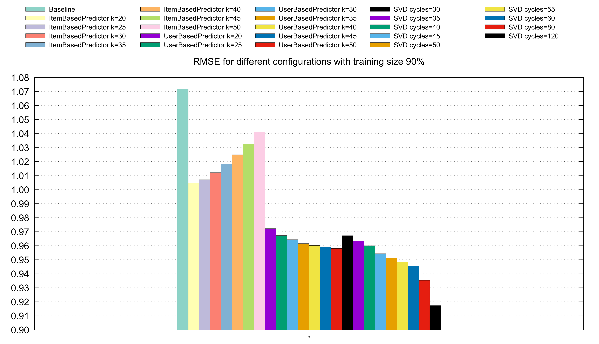
Results

Slide 9
Conclusions
Worst perfomance in all configurations with IBCF
UBCF ≈ up to 45 cycles in SVD
Starting with 50 cycles SVD achieved best results
SVD with 120 cycles was the best configuration

